Slide 1
Off the leash!
By Bronwyn Carr and Rodney Ditchfield

Slide 2
What’s covered
Purpose
Features
Target audience
Tech stack and brief overview of libraries/gems and APIs
Trello and task delegation
Picture time!
Live demo

Slide 3
Purpose
“Everyone thinks they have the best dog. And none of them are wrong.” – W.R. Purche
Over one third of households in Australia have a pet dog, giving Australia one of the highest rates of pet ownership in the world. That's over 3.6 million households with a dog eagerly waiting at the front door for it's owner, snoozing on the couch in the sun, or chasing a ball around the garden. Dogs are traditionally known as "man's best friend" and many people consider them part of their family. This app is designed to help people include their four legged family member in day-to-day activities in addition to planning outing the whole family can enjoy.
The app is designed to help people find dog friendly locations to take their four legged friends!

Slide 4
How does it work?
Off the leash ™ uses a combination of google maps and the geocoder gem to both present a map and present the saved location on the map. Think “google maps” but for dog owners.
Can’t decide on where to go? There’s a find near me function that lists the locations near you!
Upon signing up the user gets a handy dandy little email which goes over the ground rules for the site for example, this is a family site so no profanity and only the admin account can edit or delete locations since we were really going for the full “Google maps” experience. I.e prove you own this and sure you can edit it seeing as how we have cafes which may not want to be listed they can just ask for it to be taken down with the click of a button

Slide 5
User stories
The user stories for this app were fairly simple and as follows:
As a user I want a convenient way to see what facilities are available so that I know what is available.
- As a user I want to see locations of facilities, so I know where it is.
- As a user I want to see facilities on a map so that I can visualize where they are.
- As a user I want to be able to add facilities so that I can contribute to the database.
- As a user I want to be able to request admin edit or delete places so that information is always up-to-date but protected from malicious behavior.
- As a user I want to be able to rate and comment on places so that there is more feedback on the location.

Slide 6
Time for some gems and APIs!

Slide 7
Gems
API’s
These two guys right here made our authentication possible, we looked into Auth0 but decided against it
Authentication Gems
jwt
knock
Geocoding gem
geocoder
Sendgrid mailer gem
sendgrid-ruby
bullet for optimising DB queries
bullet
Rubocop for linting
rubocop
Query string gem
rack-reducer
Authentication apis
JWT decode
Geolocation services
Google maps api
React-map-box api
The gem on the left geocodes a location, the API’s on the right use the data to display it on a map

Slide 8
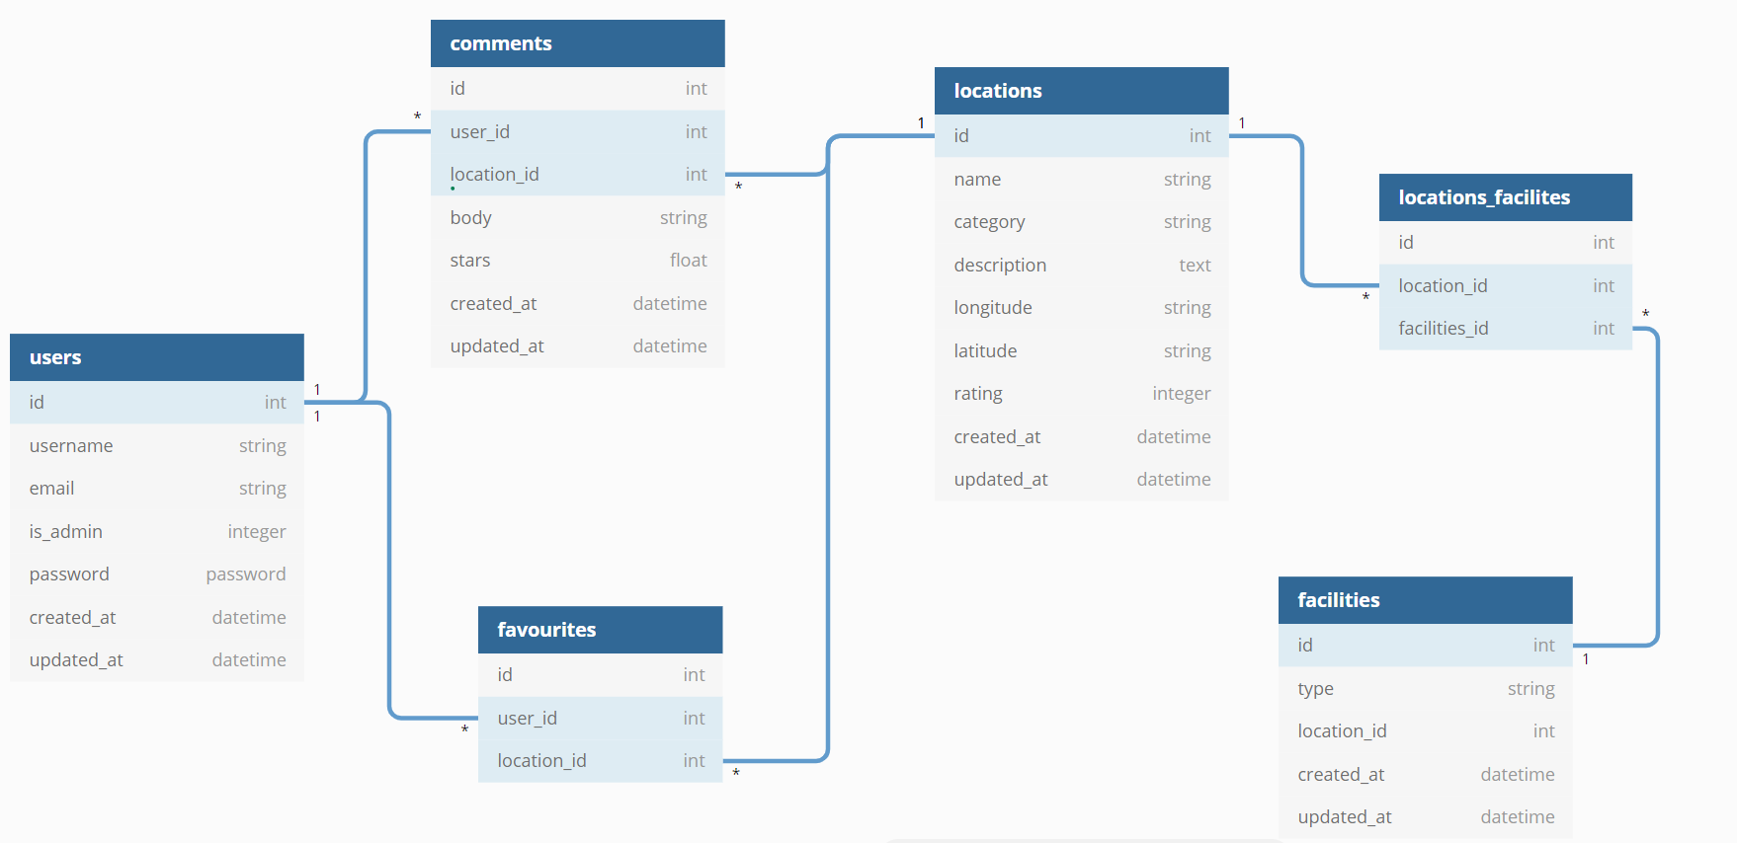
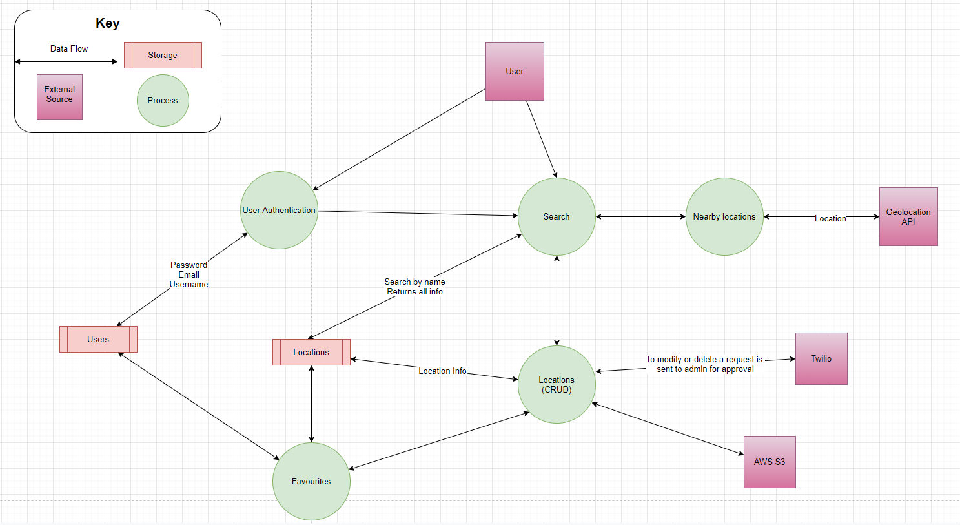
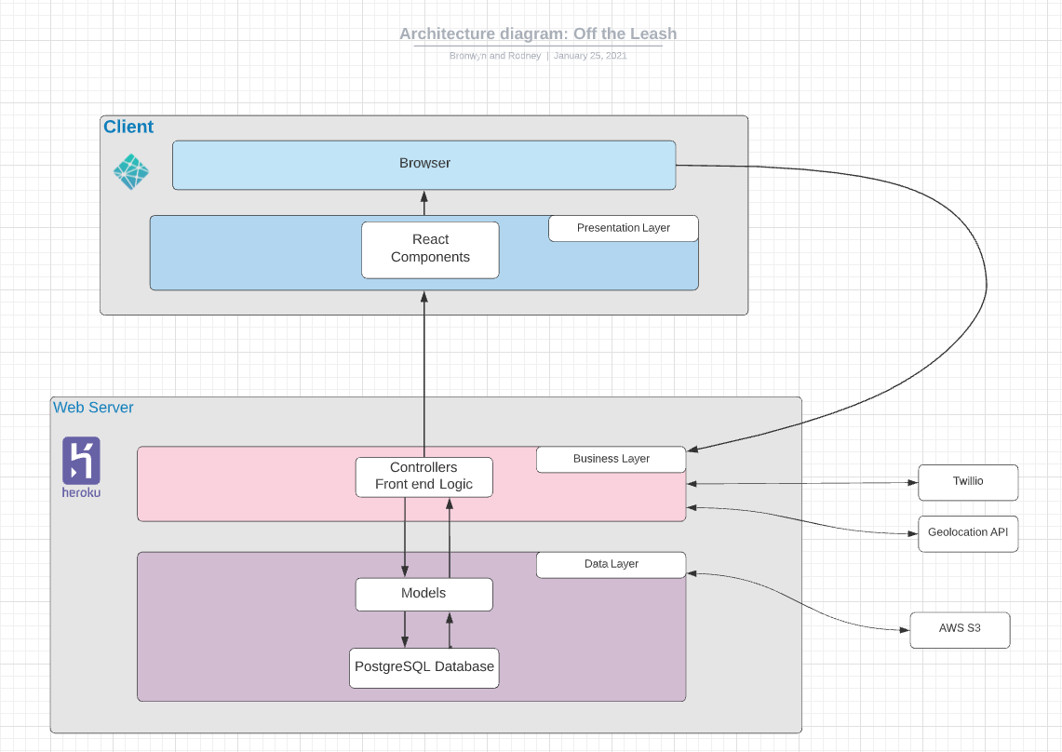
Diagrams

Slide 9
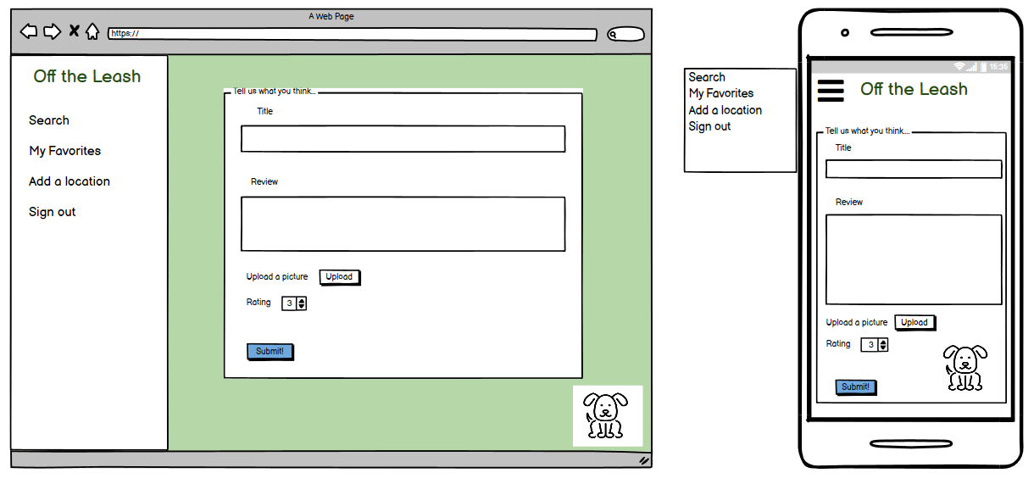
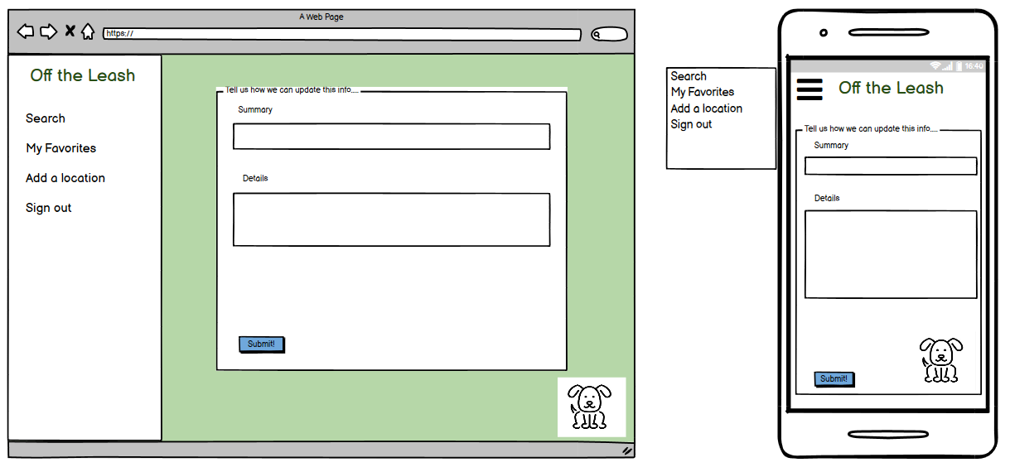
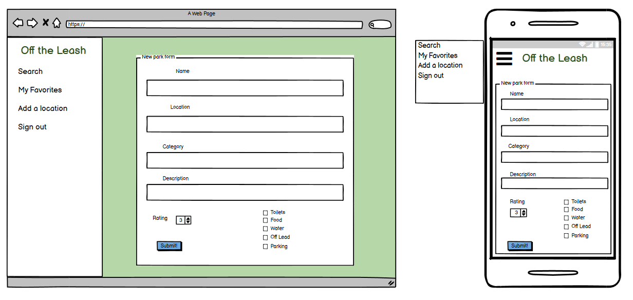
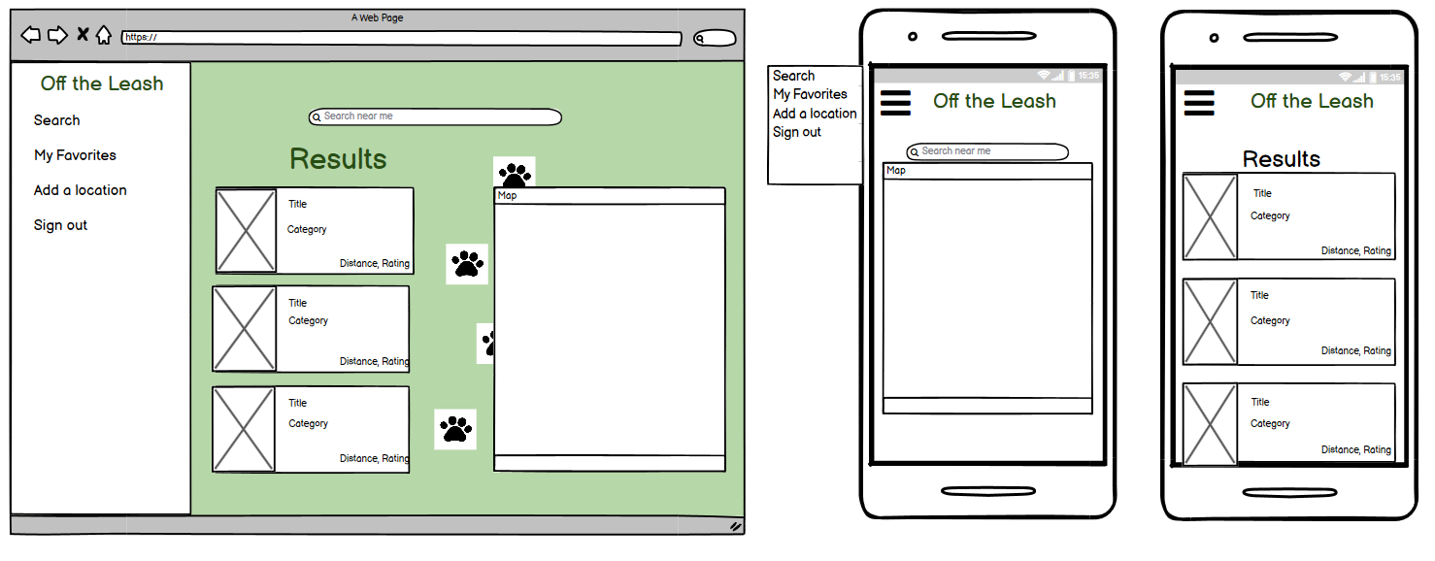
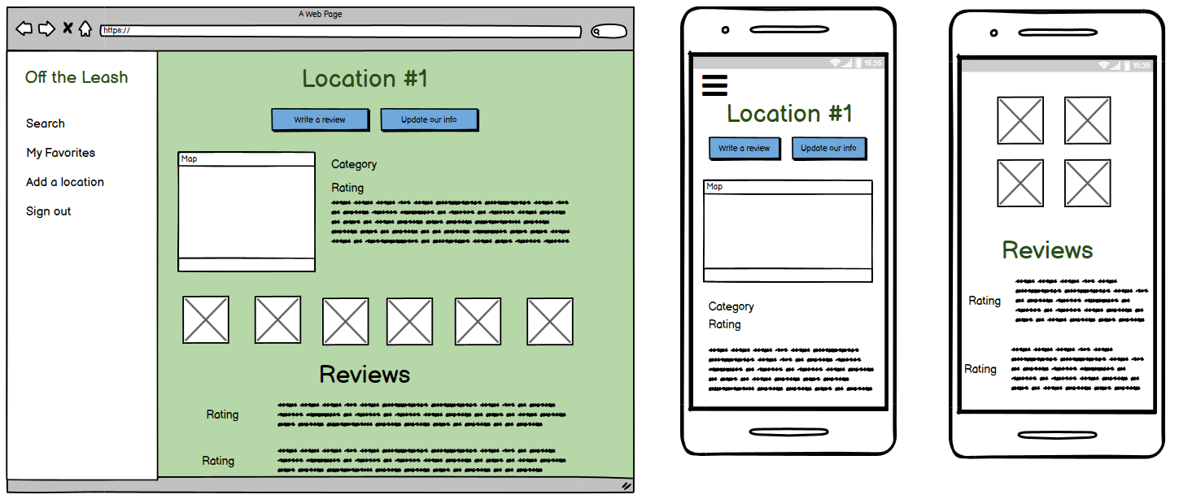
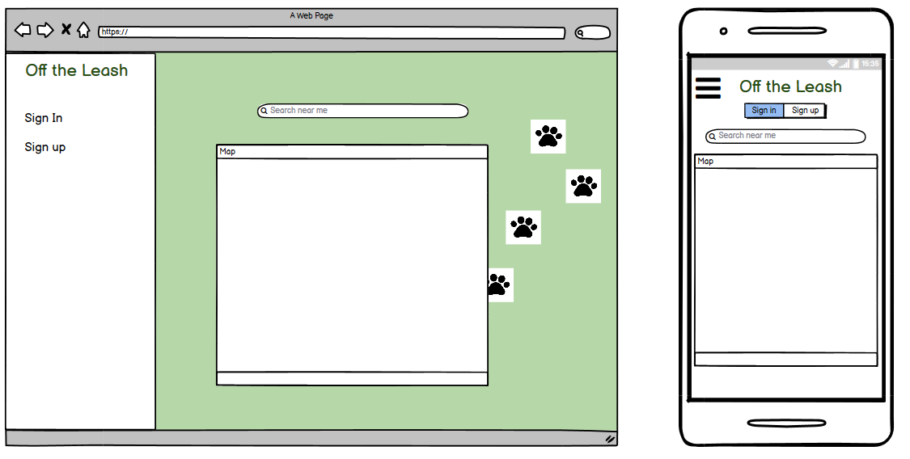
Wireframes
Review page
Modify Location
Results
New location

Slide 10
Work process
Rodney took the backend development and testing to improve his knowledge of database structures and testing practices. Bronwyn took the frontend development because she felt more confident with the React framework and Javascript overall as well as styling.
We met in person to discuss our initial concept, planning and develop our wireframes. After that we found phone calls and screen sharing on discord to be the most efficient way to communicate large problems/trouble bugs and for standups.
We held standups over the phone each morning and evening to track our progress, discuss blockers, help troubleshoot and support each other.

Slide 11
Thanks! Time for a demo!
Netlify: https://off-the-leash.netlify.app/
Trello: https://trello.com/b/113nxQTJ/off-the-leash
Excel sheet if time: https://docs.google.com/spreadsheets/d/1nBkMOCYczEhUjS3Quj4VdaXcq7aJxRsKv7s7-TjV1_o/edit#gid=0

